Slide 1
Notes on Deriving MHD
A palimpsest of Tony Arber’s ‘The Fundamentals of MHD’, James Clarke’s ‘Primer on MHD’, and Gabor Toth’s MHD Tutorial and Document on Computational MHD
by Conrad Schiff

Slide 2
References
Fundamentals of Magnetohydrodynamics (MHD) – Tony Arber
A Primer on Magnetohydrodynamics – David Clarke
Computational MHD: Tutorial – Gabor Toth
Computational Magnetohydrodynamics – Gabor Toth

Slide 3
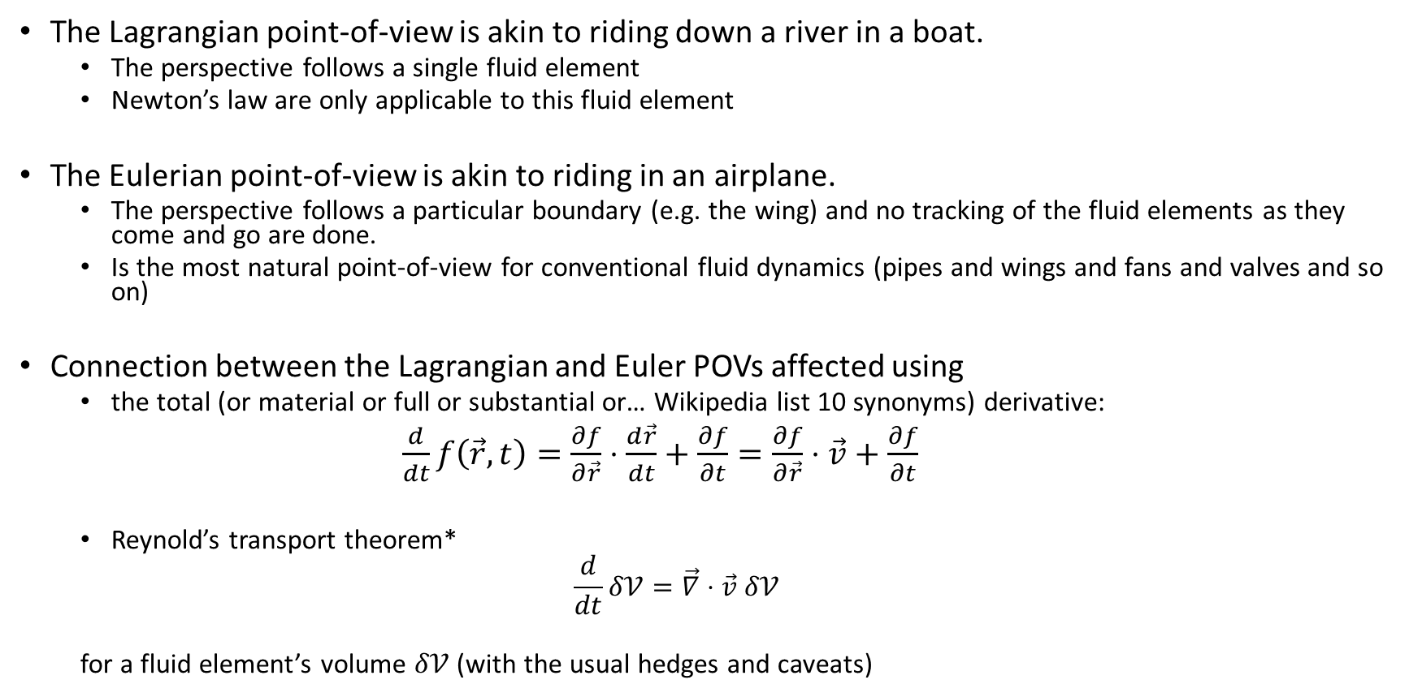
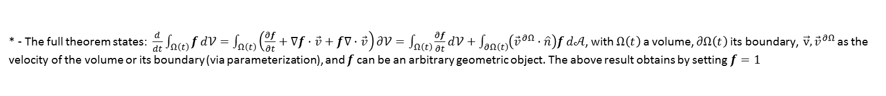
Lagrangian v. Eulerian Points-of-view (1/2)
The Lagrangian point-of-view is akin to riding down a river in a boat.
The perspective follows a single fluid element
Newton’s law are only applicable to this fluid element
The Eulerian point-of-view is akin to riding in an airplane.
The perspective follows a particular boundary (e.g. the wing) and no tracking of the fluid elements as they come and go are done.
Is the most natural point-of-view for conventional fluid dynamics (pipes and wings and fans and valves and so on)
Connection between the Lagrangian and Euler POVs affected using
the total (or material or full or substantial or… Wikipedia list 10 synonyms) derivative:
$\frac{d}{dt}f\left(\vec{r},t\right)=\frac{∂f}{∂\vec{r}}⋅\frac{d\vec{r}}{dt}+\frac{∂f}{∂t}=\frac{∂f}{∂\vec{r}}⋅\vec{v}+\frac{∂f}{∂t}$
Reynold’s transport theorem*
$$\frac{d}{dt}δ𝒱=\vec{∇}⋅\vec{v} δ𝒱$$
for a fluid element’s volume $δ𝒱$ (with the usual hedges and caveats)
* - The full theorem states: $\frac{d}{dt}\int_{Ω\left(t\right)}{f}d𝒱=\int_{Ω\left(t\right)}{\left(\frac{∂f}{∂t}+∇f⋅\vec{v}+f∇⋅\vec{v}\right)}∂𝒱=\int_{Ω\left(t\right)}{\frac{∂f}{∂t}}d𝒱+\int_{∂Ω\left(t\right)}{\left({\vec{v}}^{∂Ω}⋅\hat{n}\right)f}d𝒜$, with $Ω\left(t\right)$ a volume, $∂Ω\left(t\right)$ its boundary, $\vec{v}, {\vec{v}}^{∂Ω}$ as the velocity of the volume or its boundary (via parameterization), and $f$ can be an arbitrary geometric object. The above result obtains by setting $f=1$

Slide 4



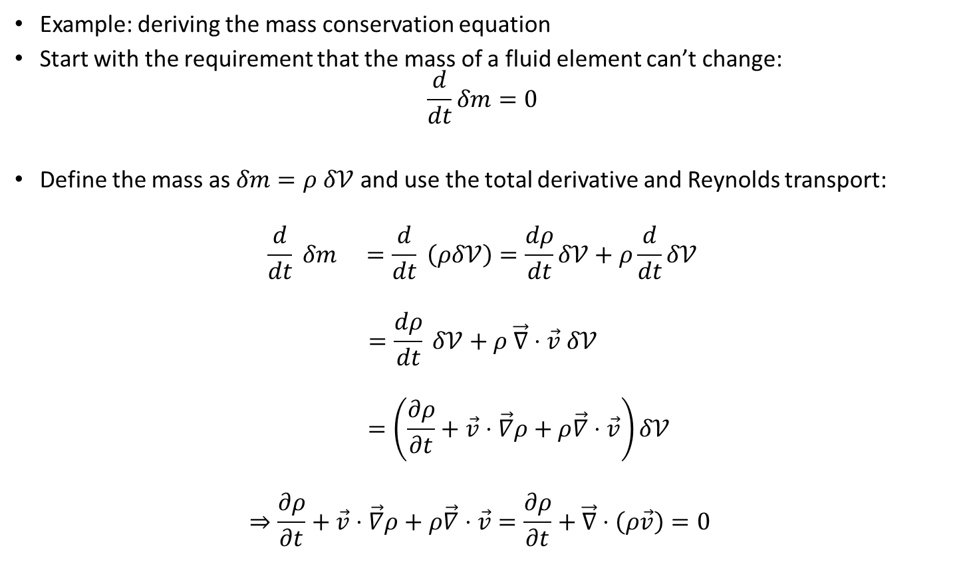



Lagrangian v. Eulerian Points-of-view (2/2)
Example: deriving the mass conservation equation
Start with the requirement that the mass of a fluid element can’t change:
$$\frac{d}{dt}δm=0$$
Define the mass as $δm=ρ δ𝒱$ and use the total derivative and Reynolds transport:
$$\frac{d}{dt} δm =\frac{d}{dt} \left(ρδ𝒱\right)=\frac{dρ}{dt}δ𝒱+ρ\frac{d}{dt}δ𝒱$$
$$=\frac{dρ}{dt} δ𝒱+ρ \vec{∇}⋅\vec{v} δ𝒱$$
$$=\left(\frac{∂ρ}{∂t}+\vec{v}⋅\vec{∇}ρ+ρ\vec{∇}⋅\vec{v}\right)δ𝒱$$
$$⇒\frac{∂ρ}{∂t}+\vec{v}⋅\vec{∇}ρ+ρ\vec{∇}⋅\vec{v}=\frac{∂ρ}{∂t}+\vec{∇}⋅\left(ρ\vec{v}\right)=0$$
$$ρ_{2}$$
$$δm$$
$$ρ_{1}$$
$$δm$$
$$δ𝒱_{2}$$
$$δ𝒱_{1}$$
Flow
density changes with the volume so that the mass is conserved

Slide 5
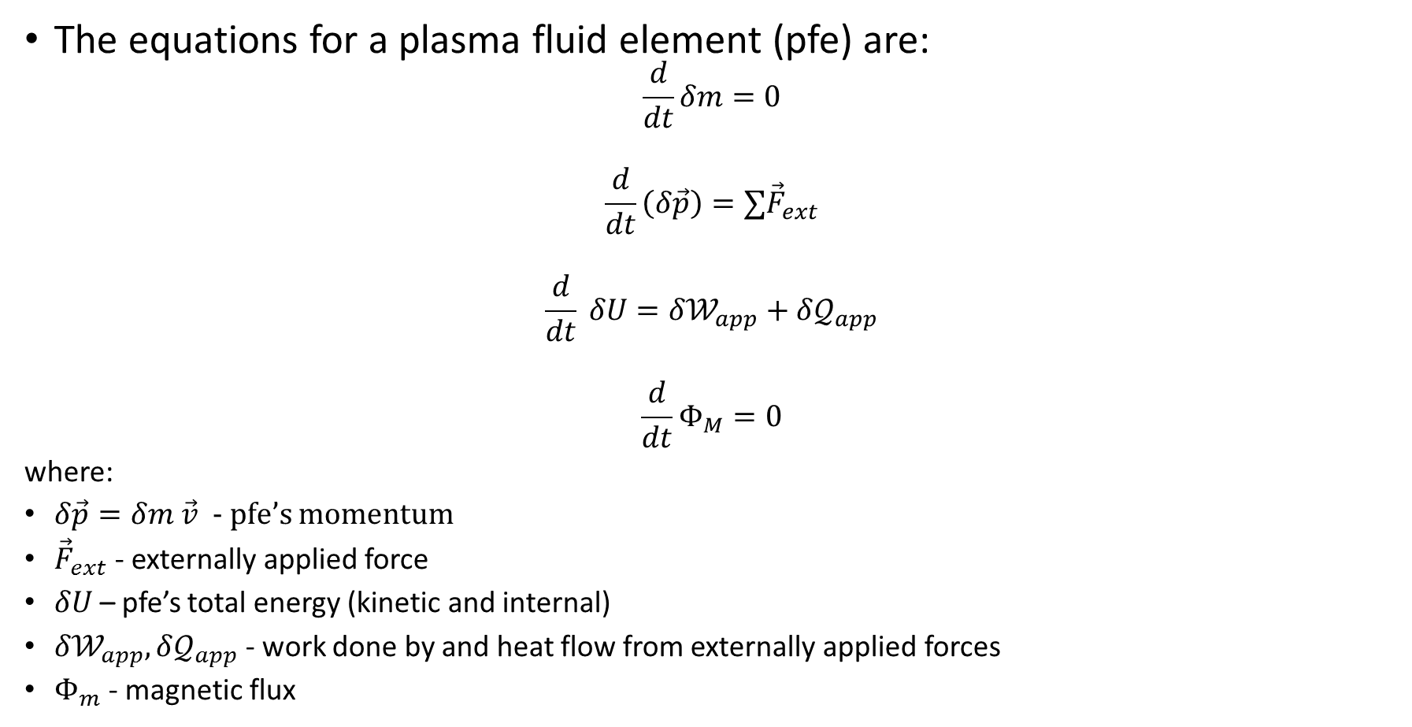
The Lagrangian Equations for a Plasma (Clarke 2)
The equations for a plasma fluid element (pfe) are:
$$\frac{d}{dt}δm=0$$
$$\frac{d}{dt}\left(δ\vec{p}\right)=∑{\vec{F}}_{ext}$$
$$\frac{d}{dt} δU={δ𝒲}_{app}+δ𝒬_{app}$$
$$\frac{d}{dt}Φ_{M}=0$$
where:
$δ\vec{p}=δm \vec{v}$ - pfe’s momentum
${\vec{F}}_{ext}$ - externally applied force
$δU$ – pfe’s total energy (kinetic and internal)
${δ𝒲}_{app}, δ𝒬_{app}$ - work done by and heat flow from externally applied forces
$Φ_{m}$ - magnetic flux
Note that this equation is the most conceptually complex as it is the first law of thermodynamics (IUPAC convention)
Frozen flux

Slide 6


Deriving MHD - Arber
N-body Klimotovich $→$ moments
Many paths to MHD
My impression in all cases is that MHD is the low-frequency thermodynamic approximation to what is really happening
Louiville theorem $→$ BBGKY hierarchy $→$ moments
MHD
Classical Fluid Dynamics

Slide 7
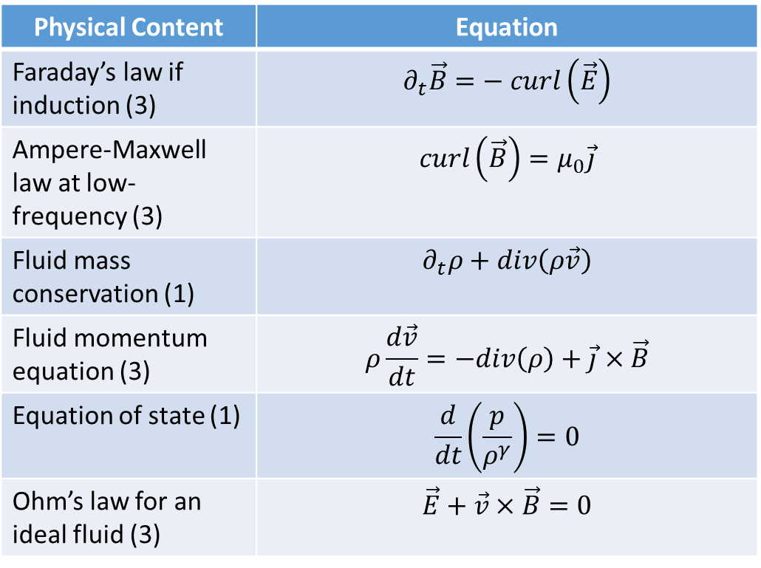
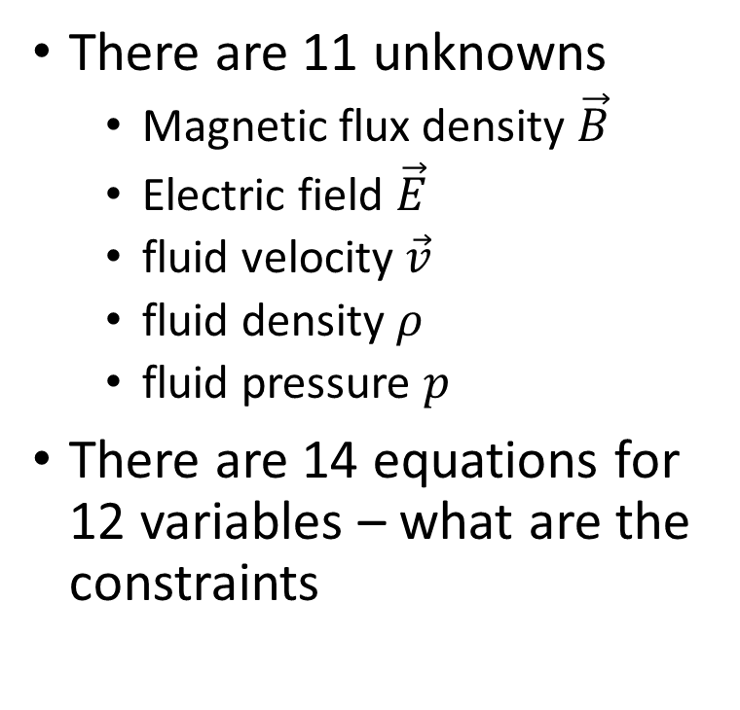
Arber’s Equations
Physical Content | Equation
Faraday’s law if induction (3) | $$∂_{t}\vec{B}=− curl\left(\vec{E}\right)$$
Ampere-Maxwell law at low-frequency (3) | $$curl\left(\vec{B}\right)=μ_{0}\vec{j}$$
Fluid mass conservation (1) | $$∂_{t}ρ+div\left(ρ\vec{v}\right)$$
Fluid momentum equation (3) | $$ρ\frac{d\vec{v}}{dt}=−div\left(ρ\right)+\vec{j}×\vec{B}$$
Equation of state (1) | $$\frac{d}{dt}\left(\frac{p}{ρ^{γ}}\right)=0$$
Ohm’s law for an ideal fluid (3) | $$\vec{E}+\vec{v}×\vec{B}=0$$
There are 11 unknowns
Magnetic flux density $\vec{B}$
Electric field $\vec{E}$
fluid velocity $\vec{v}$
fluid density $ρ$
fluid pressure $p$
There are 14 equations for 12 variables – what are the constraints

Slide 8
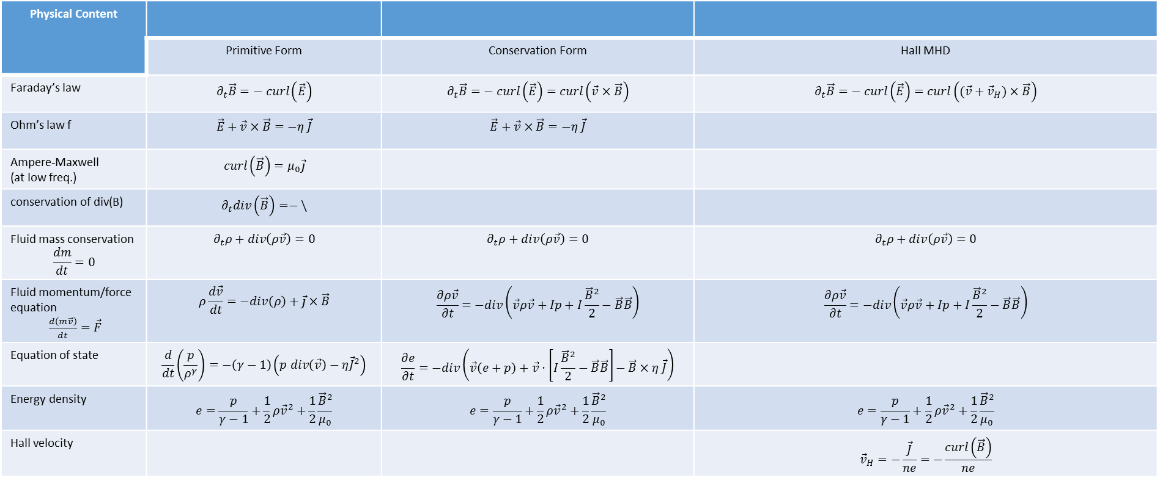
Physical Content
 | Primitive Form | Conservation Form | Hall MHD
Faraday’s law | $$∂_{t}\vec{B}=− curl\left(\vec{E}\right)$$ | $$∂_{t}\vec{B}=− curl\left(\vec{E}\right)=curl\left(\vec{v}×\vec{B}\right)$$ | $$∂_{t}\vec{B}=− curl\left(\vec{E}\right)=curl\left((\vec{v}+{\vec{v}}_{H})×\vec{B}\right)$$
Ohm’s law f | $$\vec{E}+\vec{v}×\vec{B}=−η \vec{J}$$ | $$\vec{E}+\vec{v}×\vec{B}=−η \vec{J}$$
Ampere-Maxwell (at low freq.) | $$curl\left(\vec{B}\right)=μ_{0}\vec{j}$$
conservation of div(B) | $$∂_{t}div\left(\vec{B}\right)=−\backslash$$
Fluid mass conservation $$\frac{dm}{dt}=0$$ | $$∂_{t}ρ+div\left(ρ\vec{v}\right)=0$$ | $$∂_{t}ρ+div\left(ρ\vec{v}\right)=0$$ | $$∂_{t}ρ+div\left(ρ\vec{v}\right)=0$$
Fluid momentum/force equation $\frac{d\left(m\vec{v}\right)}{dt}=\vec{F}$ | $$ρ\frac{d\vec{v}}{dt}=−div\left(ρ\right)+\vec{j}×\vec{B}$$ | $$\frac{∂ρ\vec{v}}{∂t}=−div\left(\vec{v}ρ\vec{v}+Ip+I\frac{{\vec{B}}^{2}}{2}−\vec{B}\vec{B}\right)$$ | $$\frac{∂ρ\vec{v}}{∂t}=−div\left(\vec{v}ρ\vec{v}+Ip+I\frac{{\vec{B}}^{2}}{2}−\vec{B}\vec{B}\right)$$
Equation of state | $$\frac{d}{dt}\left(\frac{p}{ρ^{γ}}\right)=−\left(γ−1\right)\left(p div\left(\vec{v}\right)−η{\vec{J}}^{2}\right)$$ | $$\frac{∂e}{∂t}=−div\left(\vec{v}\left(e+p\right)+\vec{v}⋅\left[I\frac{{\vec{B}}^{2}}{2}−\vec{B}\vec{B}\right]−\vec{B}×η \vec{J}\right)$$
Energy density | $$e=\frac{p}{γ−1}+\frac{1}{2}ρ{\vec{v}}^{2}+\frac{1}{2}\frac{{\vec{B}}^{2}}{μ_{0}}$$ | $$e=\frac{p}{γ−1}+\frac{1}{2}ρ{\vec{v}}^{2}+\frac{1}{2}\frac{{\vec{B}}^{2}}{μ_{0}}$$ | $$e=\frac{p}{γ−1}+\frac{1}{2}ρ{\vec{v}}^{2}+\frac{1}{2}\frac{{\vec{B}}^{2}}{μ_{0}}$$
Hall velocity |  |  | $${\vec{v}}_{H}=−\frac{\vec{J}}{ne}=−\frac{curl\left(\vec{B}\right)}{ne}$$

Slide 9
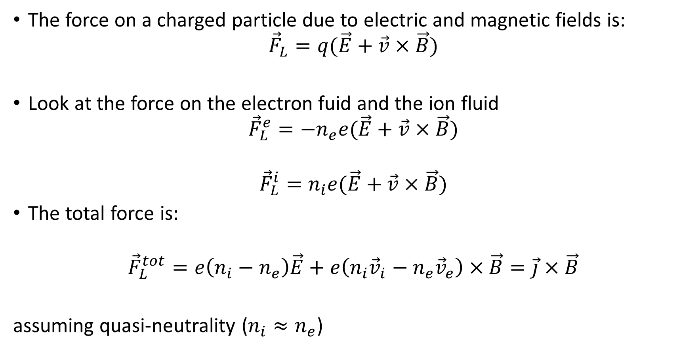
Lorentz Force in a Plasma (Arber 11)
The force on a charged particle due to electric and magnetic fields is:
$${\vec{F}}_{L}=q(\vec{E}+\vec{v}×\vec{B})$$
Look at the force on the electron fuid and the ion fluid
$${\vec{F}}_{L}^{e}=−n_{e}e(\vec{E}+\vec{v}×\vec{B})$$
$${\vec{F}}_{L}^{i}=n_{i}e(\vec{E}+\vec{v}×\vec{B})$$
The total force is:
$${\vec{F}}_{L}^{tot}=e\left(n_{i}−n_{e}\right)\vec{E}+e\left(n_{i}{\vec{v}}_{i}−n_{e}{\vec{v}}_{e}\right)×\vec{B}=\vec{j}×\vec{B}$$
assuming quasi-neutrality ($n_{i}≈n_{e}$)

Slide 10
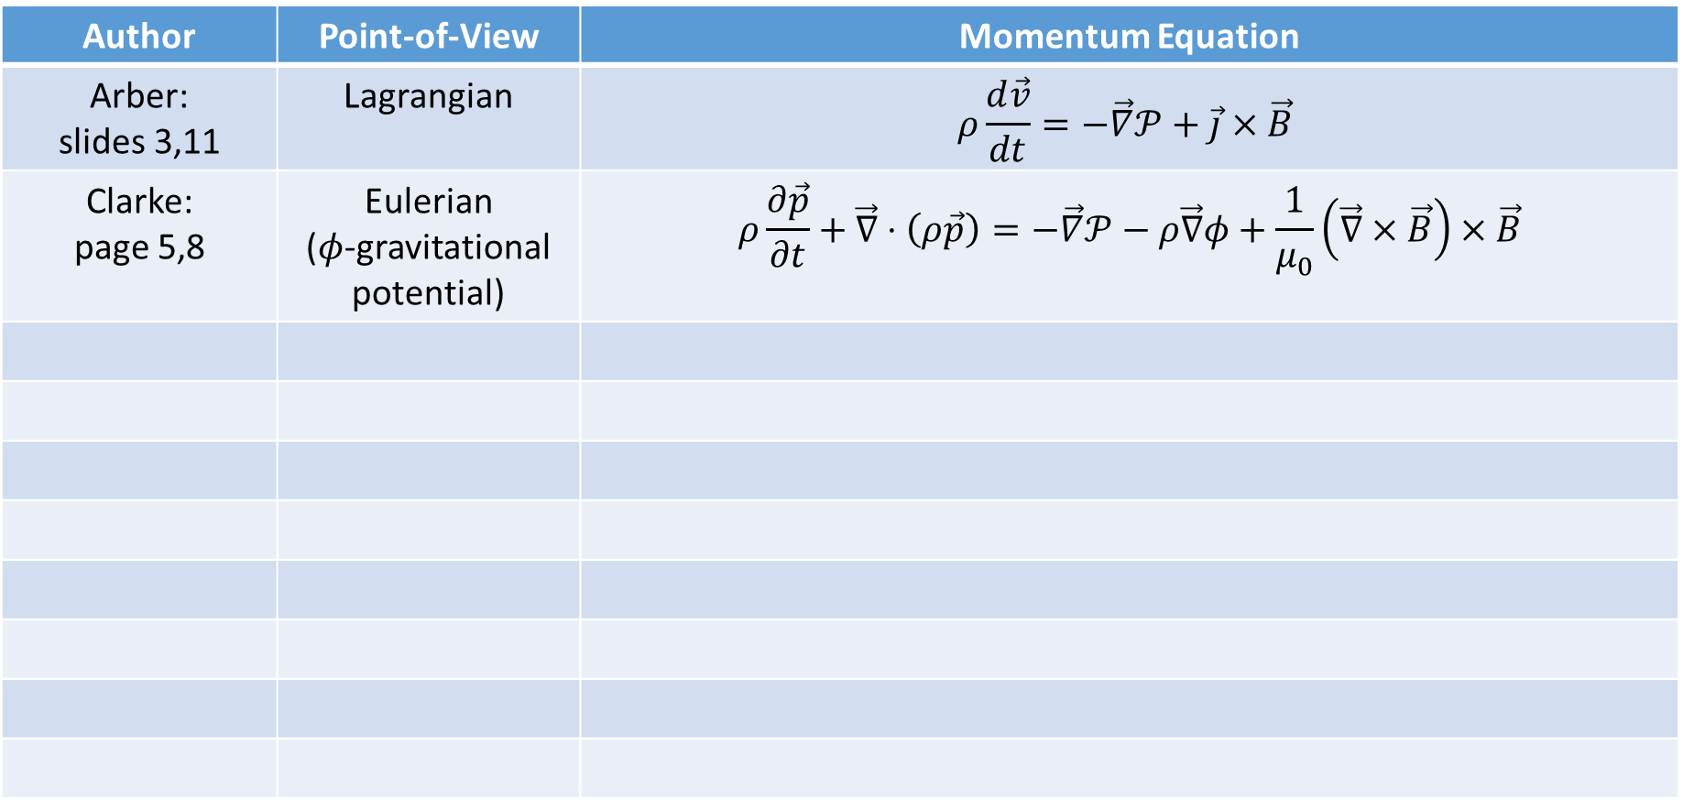
The Various Faces of the Momentum Equation
Author | Point-of-View | Momentum Equation
Arber: slides 3,11 | Lagrangian | $$ρ\frac{d\vec{v}}{dt}=−\vec{∇}𝒫+\vec{j}×\vec{B}$$
Clarke: page 5,8 | Eulerian ($φ$-gravitational potential) | $$ρ\frac{∂\vec{p}}{∂t}+\vec{∇}⋅\left(ρ\vec{p}\right)=−\vec{∇}𝒫−ρ\vec{∇}φ+\frac{1}{μ_{0}}\left(\vec{∇}×\vec{B}\right)×\vec{B}$$

Slide 11
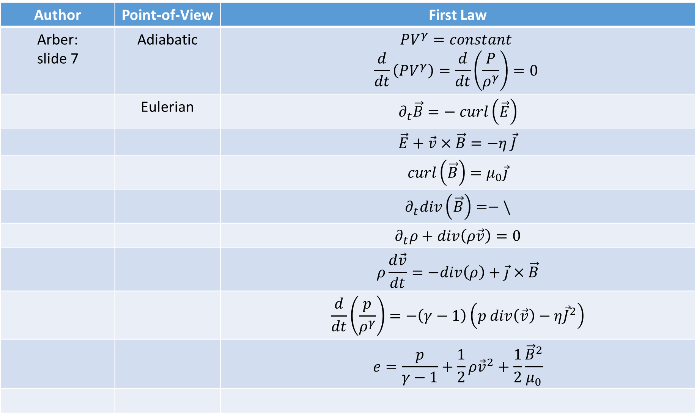
The Various Faces of the First Law
Author | Point-of-View | First Law
Arber: slide 7 | Adiabatic | $$PV^{γ}=constant$$ $$\frac{d}{dt}\left(PV^{γ}\right)=\frac{d}{dt}\left(\frac{P}{ρ^{γ}}\right)=0$$
 | Eulerian | $$∂_{t}\vec{B}=− curl\left(\vec{E}\right)$$
 |  | $$\vec{E}+\vec{v}×\vec{B}=−η \vec{J}$$
 |  | $$curl\left(\vec{B}\right)=μ_{0}\vec{j}$$
 |  | $$∂_{t}div\left(\vec{B}\right)=−\backslash$$
 |  | $$∂_{t}ρ+div\left(ρ\vec{v}\right)=0$$
 |  | $$ρ\frac{d\vec{v}}{dt}=−div\left(ρ\right)+\vec{j}×\vec{B}$$
 |  | $$\frac{d}{dt}\left(\frac{p}{ρ^{γ}}\right)=−\left(γ−1\right)\left(p div\left(\vec{v}\right)−η{\vec{J}}^{2}\right)$$
 |  | $$e=\frac{p}{γ−1}+\frac{1}{2}ρ{\vec{v}}^{2}+\frac{1}{2}\frac{{\vec{B}}^{2}}{μ_{0}}$$

Slide 12
[1] - http://www.whoi.edu/fileserver.do?id=25330&pt=2&p=30169
specify the stress tensor in terms of the properties of the flow, in particular the velocity field, so that the theory becomes “closed”, that is, the number of variables is reduced to the number of governing equations
http://www.whoi.edu/sbl/liteSite.do?litesiteid=8155&articleId=12164

